Slide 1


John Mangiaracina
Mar 31, 2022

Slide 2

Outline
Executive Summary
Introduction
Methodology
Results
Conclusion
References
Acknowledgements
Appendix

Slide 3
Executive Summary
Accepted and state of the art Data Science and Machine Modeling techniques developed mathematical models for the success of launch vehicle recovery for the SpaceX booster program. Launch vehicle recovery is CRITICAL to reducing costs and ensuring SpaceX's leadership role in the industry.
With a 77% success rate of recovery from the top performing launch sites , SpaceX has a clear advantage over all competitors.
The Decision Tree Classifier Model was selected as the model with the highest level of accuracy over all models considered, at 87.5%, a very high level.
The company is showing a generally increasing trend in success rate recovery over time. A very good sign that the organization is learning and implementing continuous improvement!

Slide 4
Introduction
Unprecedented need to place Communication Satellites, Intelligence Gathering Satellites, Military Hardware, Satellites for the Needs of Pure Science, and Manned Spacecraft in Earth Orbit , Solar Orbit, and Beyond
The Future holds incredible promise for Advanced Defense Systems and both Un-Manned and Manned Missions to Mars … and that is Just the Beginning!
The Key Factor in advancing space exploration, travel, and economic development is having a launch cost structure that is FAR cheaper than all competition. This requires reusable First Stages and knowing the probability of reuse.

Slide 5

Section 1

Slide 6
Methodology, part 1
Methodology Executive Summary
Data collection methodology:
Web scraping techniques were utilized on the SpaceX Launches data site and the SpaceX Wikipedia page
Data wrangling
Data wrangling and data cleaning were conducted in jupyter notebooks utilizing the python programming language with various open source tools
Exploratory Data Analysis (EDA) was conducted using various data science open source libraries and queries were conducted with SQL

Slide 7
Methodology, part 2
Methodology Executive Summary
Interactive visual analytics were conducted using Folium, Plotly, and Dash
Predictive analysis using classification machine models
Cleaned and processed dataset of all launches classified by payload, launch site, and success/failure of reuse of first stage was split into testing and training datasets. Logistic Regression, Support Vector Machine, Decision Classifier Tree, and K Nearest Neighbors Machine Learning Models were Evaluated to find the best Model. We found the Decision Tree Classifier Model to be the most accurate.

Slide 8
Data Collection
Data sets were collected from the SpaceX Launch data web site:
"https://api.spacexdata.com/v4/launches/past"
Falcon9 Data was scraped from the web site:
"https://en.wikipedia.org/w/index.php?title=List_of_Falcon_9_and_Falcon_Heavy_launches&oldid=1027686922"

Slide 9
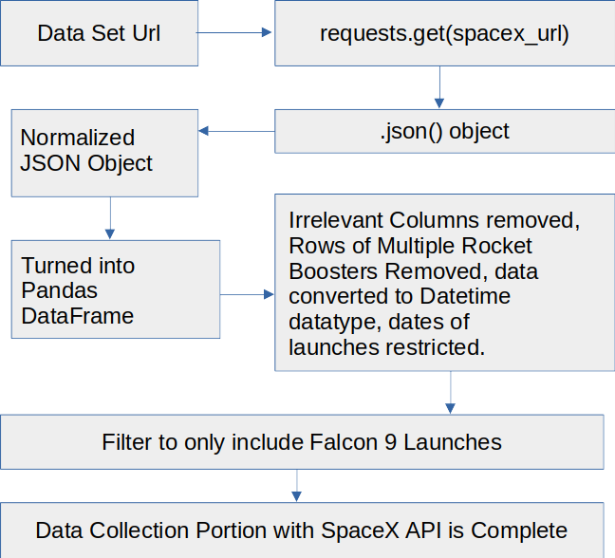
Data Collection – SpaceX API
Flowchart of Data Collection Process is to the right
The Jupyter Notebook of the entire SpaceX Data Collection Process is available at:
https://github.com/EasyAs12345/coursera-capstone-project/blob/master/Completed_Lab_Data%20Collection%20API%20Lab.ipynb

Slide 10
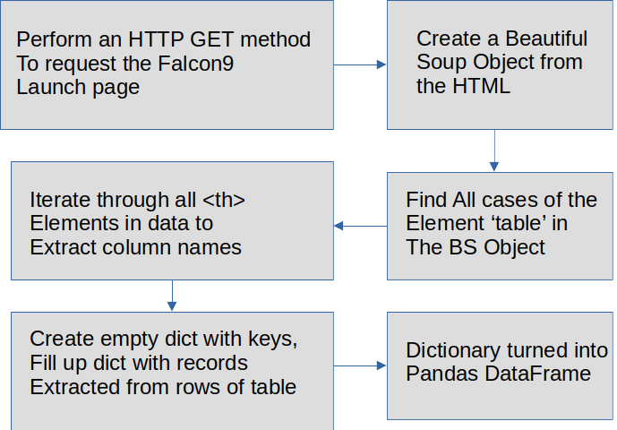
Data Collection - Scraping
Webscraping Process Flowchart is to the right
The web scraping jupyter notebook is available at:
https://github.com/EasyAs12345/coursera-capstone-project/blob/master/Completed_Lab_Data%20Collection%20with%20Web%20Scraping.ipynb

Slide 11
Data Wrangling
Data Wrangling Focused on determining which key values of interest were missing in the dataset.
We applied the .isnull() method to the Falcon9 data to determine this
It was decided to apply the .mean() method to take the average of the data that does exist for a particular attribute, and then replace the missing data of a particular attribute with the mean of said attribute.
Data Wrangling can be found in the Jupyter Notebook located at:
https://github.com/EasyAs12345/coursera-capstone-project/blob/master/Completed_Lab_Data%20Collection%20API%20Lab.ipynb
And
https://github.com/EasyAs12345/coursera-capstone-project/blob/master/Completed_Lab_EDA.ipynb

Slide 12
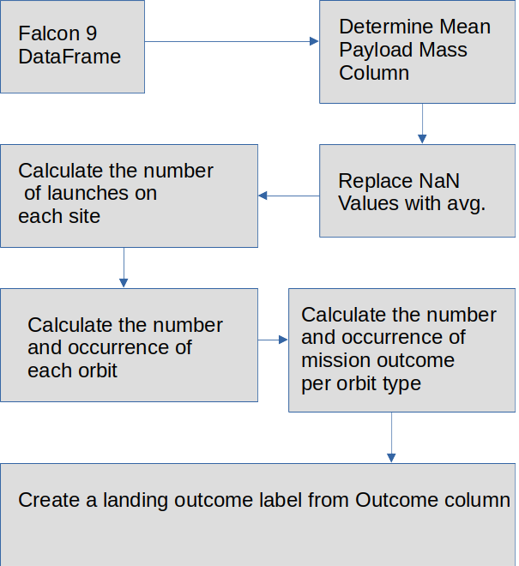
Data Wrangling Flow Chart

Slide 13
EDA with Data Visualization, Part 1
Summary of Charts Plotted as part of EDA
Payload Mass (kg) vs. Flight Number: To see if the Rate of success of recovery trended over successive launches (if the system learned and got better), but also to see whether there was any change in the quantity of the payload over successive launches.
CCAFS LC-40, has a success rate of 60 %, while KSC LC-39A and VAFB SLC 4E have a success rate of 77%.
Launch Site vs. Flight Number: To see if there was a difference over time in success of launch recovery based on where the Rocket was launched from, and to see how launch site selection varied over time.
Launch Recovery Rate increase over time at VAFB and KSC, not as clear cut at CCAFS
Launch Site vs. Payload Mass: To see any preferences for Launch Site based on the amount of mass to be launched, and to see how success rate of launch vehicle recovery varied by launch site for groupings of payload mass.
No Launches above 10KG from VAFB, slight advantage of successful recovery with very high Payload mass at CCAFS

Slide 14
EDA with Data Visualization, Part 2
Summary of Charts Plotted as part of EDA, cont.
Orbit Class vs. Orbit: To see the sucess rate of each type of Orbit.
ES-L1, SSO, HEO, and GEO had the highest success rate of 1.0 = 100%!
Orbit vs. Flight Number: To see variation over time of actual orbit of payload over time, and also success of launch vehicle recovery over time (Flight Number).
With Geo and MEO, greater success over time. Others see no difference over time.
Orbit vs. PayloadMass: To see any trends in Orbit selection based on differences in the Mass of the Payload (a larger mass requires more Energy to drive it higher in the atmosphere before reaching outer space.)
Polar, LEO, and ISS Orbits, when launching heavy payloads, have a greater success rate of successful launch vehicle recovery

Slide 15
EDA with Data Visualization, Part 3
Summary of Charts Plotted as part of EDA, cont.
Success Rate vs Time: To see if Launch Vehicle Recovery improved or not over time. To see if the organization is getting better, worse, or neutral over time.
Overall, the success rate of launch vehicle recovery has been on a trending upward curve from 2013 – 2020!
Very good news for SpaceX as a whole … although always room for improvement!
The complete EDA with data visualization notebook is available at:
https://github.com/EasyAs12345/coursera-capstone-project/blob/master/Completed_Lab%20Complete%20the%20EDA%20with%20Visualization%20lab.ipynb

Slide 16
EDA with SQL, Part 1
Utilizing SQL queries, I explored:
What are the unique launch sites that were used:
CCAFS LC-40, CCAFS SLC-40, KSC LC-39A, and VAFB SLC-4E
To see launch sites that begin with the string 'CCA'
Display the total payload mass carried by boosters launched by NASA (CRS)
48213 kg.
Display average payload mass carried by booster version F9 v1.1
3890 kg.
List the date when the first successful landing outcome in ground pad was achieved.
22 Dec 2015

Slide 17
EDA with SQL, Part 2
Utilizing SQL queries, I explored (cont):
List the names of the boosters which have success in drone ship and have payload mass greater than 4000 but less than 6000
List the total number of successful and failure mission outcomes (No aspect of success at all)
100 Successful
1 Unsuccessful
booster_version | landing__outcome | payload_mass__kg_
F9 FT B1022 | Success (drone ship) | 4696
F9 FT B1026 | Success (drone ship) | 4600
F9 FT B1021.2 | Success (drone ship) | 5300
F9 FT B1031.2 | Success (drone ship) | 5200

Slide 18
EDA with SQL, Part 3
booster_version | payload_mass__kg_
F9 B5 B1048.4 | 15600
F9 B5 B1049.4 | 15600
F9 B5 B1051.3 | 15600
F9 B5 B1056.4 | 15600
F9 B5 B1048.5 | 15600
F9 B5 B1051.4 | 15600
F9 B5 B1049.5 | 15600
F9 B5 B1060.2 | 15600
F9 B5 B1058.3 | 15600
F9 B5 B1051.6 | 15600
F9 B5 B1060.3 | 15600
F9 B5 B1049.7 | 15600
Utilizing SQL queries, I explored (cont):
List the names of the booster versions which have carried the maximum payload mass. (List on the right)

Slide 19
EDA with SQL, Part 4
Utilizing SQL queries, I explored (cont):
List the failed landing_outcomes in drone ship, their booster versions, and launch site names for in year 2015
landing__outcome | booster_version | launch_site | DATE
Failure (drone ship) | F9 v1.1 B1012 | CCAFS LC-40 | 2015-01-10
Failure (drone ship) | F9 v1.1 B1015 | CCAFS LC-40 | 2015-04-14

Slide 20
EDA with SQL, Part 5
Utilizing SQL queries, I explored (cont):
Rank the count of landing outcomes (such as Failure (drone ship) or Success (ground pad)) between the date 2010-06-04 and 2017-03-20, in descending order
number | landing__outcome | ranking
10 | No attempt | 1
5 | Failure (drone ship) | 2
5 | Success (drone ship) | 2
3 | Controlled (ocean) | 4
3 | Success (ground pad) | 4
2 | Failure (parachute) | 6
2 | Uncontrolled (ocean) | 6
1 | Precluded (drone ship) | 8

Slide 21
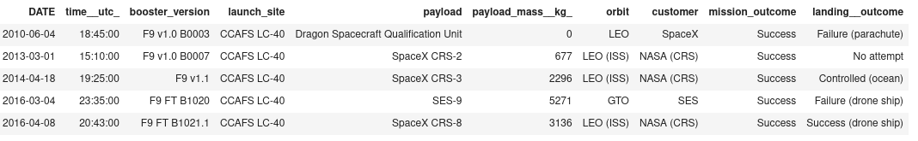
EDA with SQL, Part 6
Utilizing SQL queries, I explored (cont):
List Launches launched on a Friday
Jupyter Notebook is available at:
https://github.com/EasyAs12345/coursera-capstone-project/blob/master/Completed_Lab%20EDA%20with%20SQL.ipynb

Slide 22
Build an Interactive Map with Folium
A series of map objects were added to a folium map
site_map.add_child(circle) was used to add a circle to the map for NASA in Texas, as well as the three launch sites in Florida and the one launch site in California
site_map.add_child(marker) was used to add markers such as text designations for the various sites
site_map.add_child(lines) was used to indictate a line marking the distance of the Vandenburg launch site to the Ocean shore, as well as from the launch site to the US Forest Service Jet Center in nearby Santa Maria, CA
These indicators were added to the map to greater clarify and explain the exact locations of the launch sites discussed in the study. Also, to demonstrate the capability, such as determining distances based of (lat, log) data and then drawing a line to indicate said distance (as the crow flies.) Very cool!
The GitHub URL is available at:
https://github.com/EasyAs12345/coursera-capstone-project/blob/master/Completed_Lab_Interactive%20Visual%20Analytics%20with%20Folium%20lab.ipynb

Slide 23
Build a Dashboard with Plotly Dash
A Dashboard was created entitled "SpaceX Launch Records Dashboard".
The Dashboard includes a dropdown menu to select either all launch sites for consideration, or the option to choose an individual launch site.
The first graphic is a pie chart showing the percentage breakdown for total successes for launches based on site option from the dropdown.
There is a slide to choose the total Payload range mass (0 – 10,000 kg)
The bottom graphic is a scatter plot showing Orbit Class vs Payload Mass. Launch site data is selected based on the top dropdown. This allows us to see the success (1) or failure (0) of the mission based on payload mass. Color coding is used to indicate the booster version category.
This visual is very helpful in allowing a user to see how success and failure of launch vehicle recovery varies based on the total mass of the payload and based on launch category. Being able to explore this helps understand where the greatest success is and where efforts need to be focused to improve.

Slide 24
Build a Dashboard with Plotly Dash, part 2
A copy of the Python source code for this is available at:
https://github.com/EasyAs12345/coursera-capstone-project/blob/master/spacex_launch_dashboard_code.py
Note: It has been tested on both the IBM Skills Network Docker based setup and on a Workstation running Linux Fedora with the latest version of the Anaconda Data Science developers suite.

Slide 25
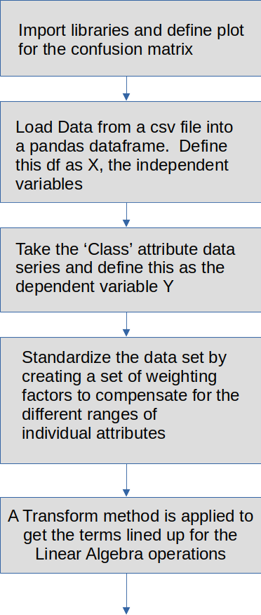
Predictive Analysis (Classification), part 1
The top portion of the Flow Chart is shown on the right and on successive pages
We imported necessary libraries, define out confusion matrix plot function, loaded the dataset from a csv file, turned it into a dataframe, broke it out to define dependent and independent variables.
We standardized the dataset by depending appropriate weighting factors for the attributes, and conducted a transform.

Slide 26
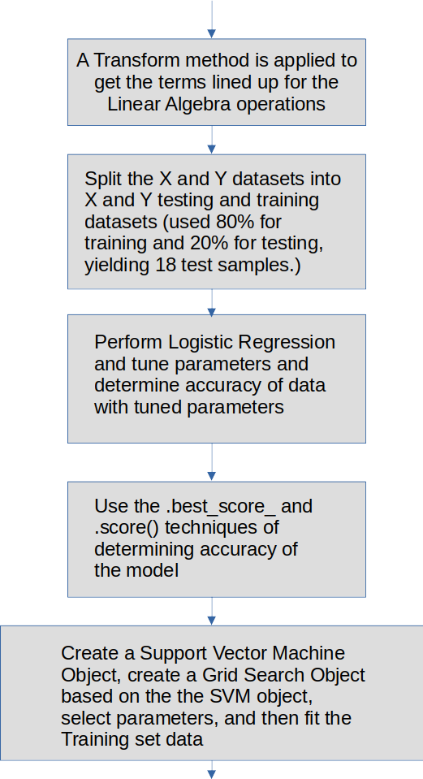
Predictive Analysis (Classification), part 2
We split the dependent and independent variables into training and testing datasets
We then performed a Logistic Regression as the first of our series of Algorithms.
We tuned parameters, found best case, and then determined the accuracy with two different techniques.
We same approach was then repeated for Support Vector Machine

Slide 27
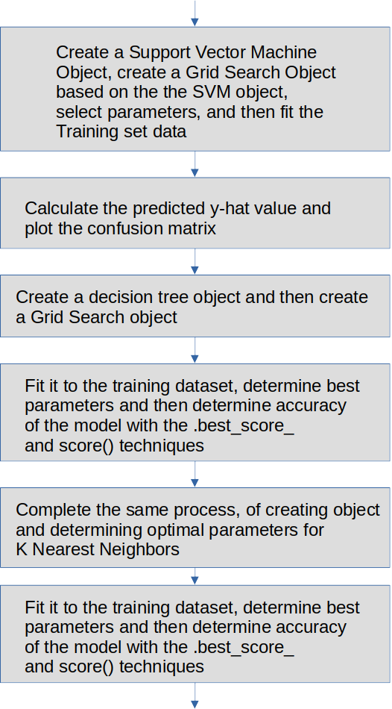
Predictive Analysis (Classification), part 3
The same approach was then taken for Decision Tree and for K Nearest Neighbors

Slide 28
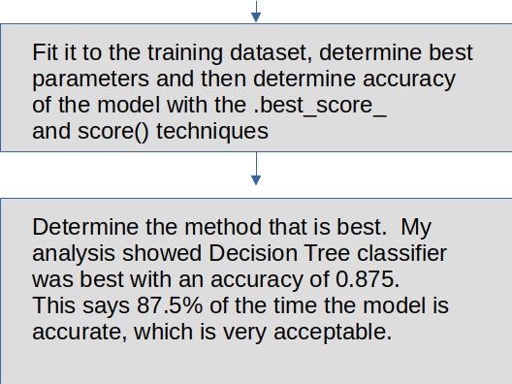
Predictive Analysis (Classification), part 4
Based on the dataset and our breakdown of training/testing data, we determined the Decision Tree Classifier had the highest accuracy, at 87.5%, a very acceptable number.
The jupyter notebook for this analysis is available at:
https://github.com/EasyAs12345/coursera-capstone-project/blob/master/Completed_Machine%20Learning%20Prediction%20Project%20Capstone%20Course%20FINAL.ipynb

Slide 29
Results
Summary of results from the EDA:
CCAFS LC-40, has a success rate of 60 %, while KSC LC-39A and VAFB SLC 4E have a success rate of 77%.
Launch Recovery Rate increase over time at VAFB and KSC, not as clear cut at CCAFS
No Launches above 10KG from VAFB, slight advantage of successful recovery with very high Payload mass at CCAFS

Slide 30
Results, cont.
Summary of results from the EDA (cont):
ES-L1, SSO, HEO, and GEO had the highest success rate of 1.0 = 100%!
With Geo and MEO, greater success over time. Others see no difference over time.
Polar, LEO, and ISS Orbits, when launching heavy payloads, have a greater success rate of successful launch vehicle recovery

Slide 31
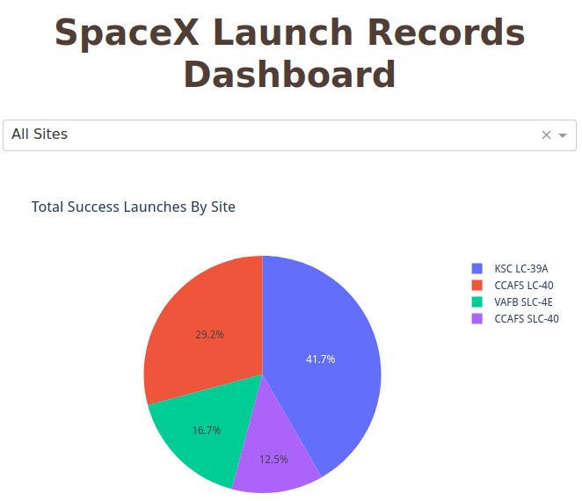
Results, cont.
Interactive analytics demo screenshot of the SpaceX Launch Records Dashboard, ALL Sites selected from the dropdown.

Slide 32
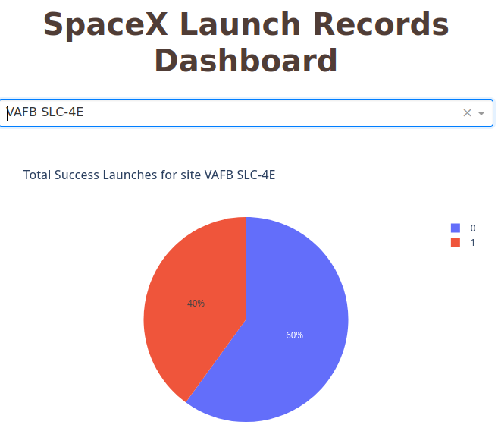
Results, cont.
Interactive analytics demo screenshot of the SpaceX Launch Records Dashboard, Vandenburg VAFB selected from the dropdown.

Slide 33
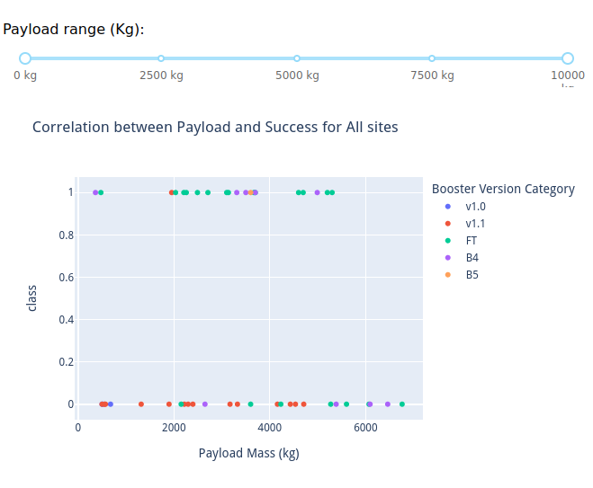
Results, cont.
Interactive analytics demo screenshot of the SpaceX Launch Records Dashboard, All Sites selected from the dropdown, showing the Full Slider Range and the scatter plot for correlation between Payload and Success for ALL Sites, color coded by booster version

Slide 34
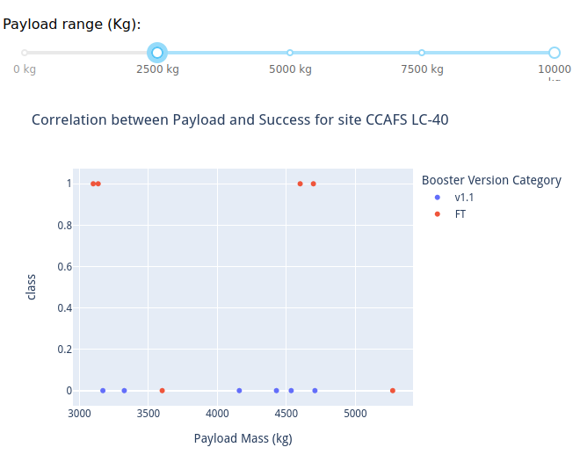
Results, cont.
Interactive analytics demo screenshot of the SpaceX Launch Records Dashboard, CCAFS LC-40 selected from the dropdown, showing the 2500kg to 10000 kg and the scatter plot for correlation between Payload and Success for only CCAFS LC-40, color coded by booster version

Slide 35
Results, cont.
Based on the dataset and our breakdown of training/testing data, the Predictive Analytics determined the Decision Tree Classifier had the highest accuracy, at 87.5%, a very acceptable number.

Slide 36

Section 2

Slide 37
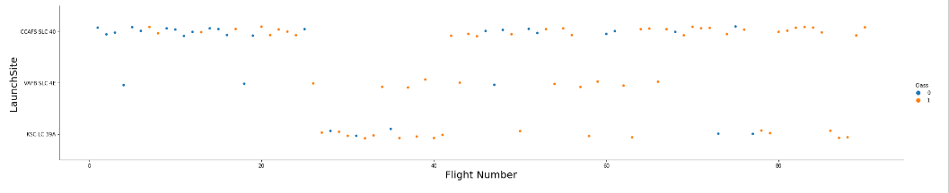
Flight Number vs. Launch Site
Scatter plot of Flight Number vs. Launch Site
This Scatter Plot groups launches by launch site and displays it over time, while color coding the success (1) or failure (0) of recovery

Slide 38
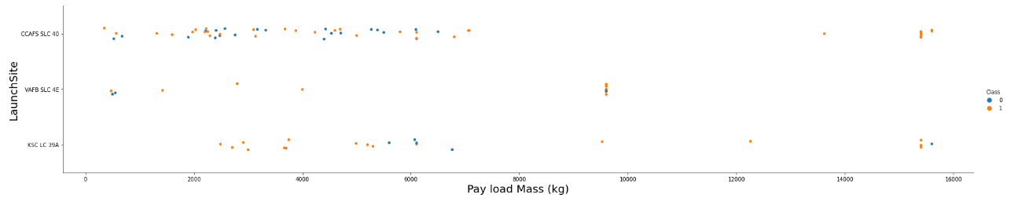
Payload vs. Launch Site
Scatter plot of Payload vs. Launch Site
This Scatter plot of Launch Site vs. Payload Mass groups missions by Payload across the different launch sites, with color coding by success (1) or failure (0) of recovery.

Slide 39
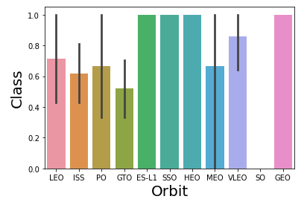
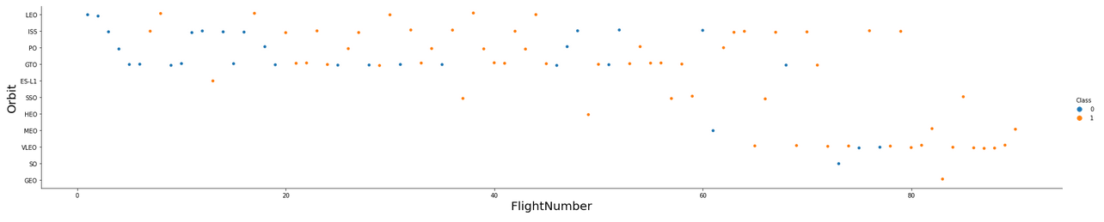
Success Rate vs. Orbit Type
Bar chart for the success rate of each orbit type:
Scatter plot of Flight Number vs. Launch Site:

Slide 40
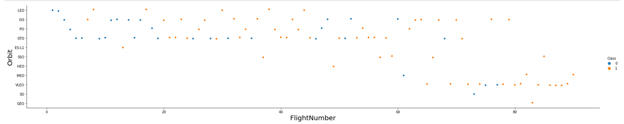
Flight Number vs. Orbit Type
Scatter plot of Flight number vs. Orbit type
This scatter plot shows us how the success of launch vehicle recovery varied over time (Flight Number), as well as selection for different Orbit Class varied over time (Flight Number). This allows us to see quickly how trends may have appeared of greater degrees of success over time for each of the Orbits!

Slide 41
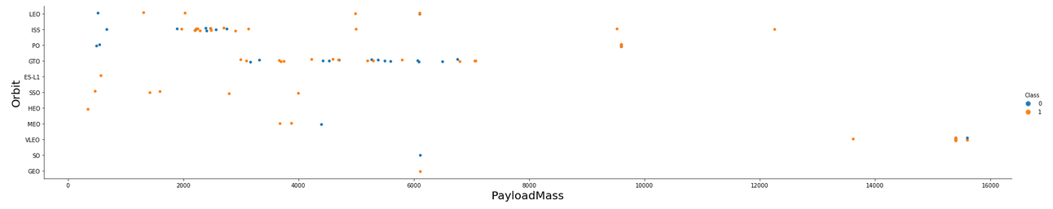
Payload vs. Orbit Type
Scatter Plot of Payload vs. Orbit type
This plot shows us a very interesting grouping of ranges of payload masses for the different orbits that said masses are launched into. There appears to be no payloads launched into the GTO orbit above 7000 kg, whereas the VLEO (Very Low Earth Orbit) seems to have all payloads above 13000 kg. This makes sense since for a given amount of propulsion, a greater mass would not be able to be launched as high in the atmosphere!

Slide 42
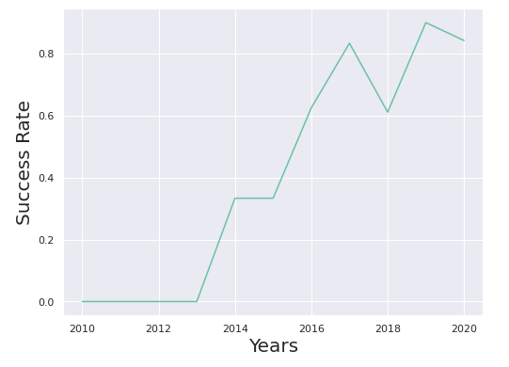
Launch Success Yearly Trend
Line chart of yearly average success rate is shown at the right:
The plot shows how there is a generally overall uptrend in success rate from 2013 – 2020, with some hiccups.
This shows the organization is learning and improving their technology and processes and is a good overall sign for SpaceX.

Slide 43
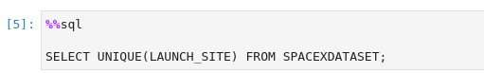
All Launch Site Names
CCAFS LC-40
CCAFS SLC-40
KSC LC-39A
VAFB SLC-4E
Find the names of the unique launch sites
The unique launch sites are in the table to the right
The SQL code to determine this is:
This SQL code will return the launch site names from the table of data. The UNIQUE command will assure that there are no duplicates returned.

Slide 44
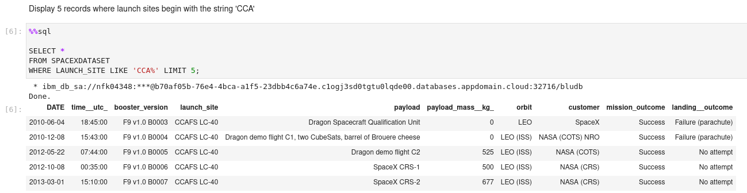
Launch Site Names Begin with 'CCA'
Find 5 records where launch sites begin with `CCA`:
This query returns a limit of 5 records where the launch site entry starts with the string 'CCA'

Slide 45
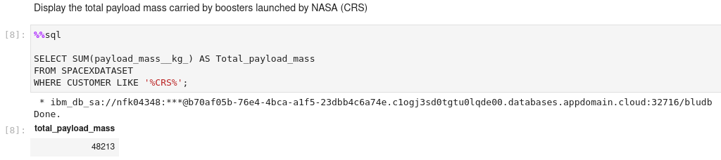
Total Payload Mass
Calculate the total payload carried by boosters from NASA:
This query adds up all of the payload masses which contains the customer designation 'CRS' for NASA and determined it was 48,213 kg.

Slide 46
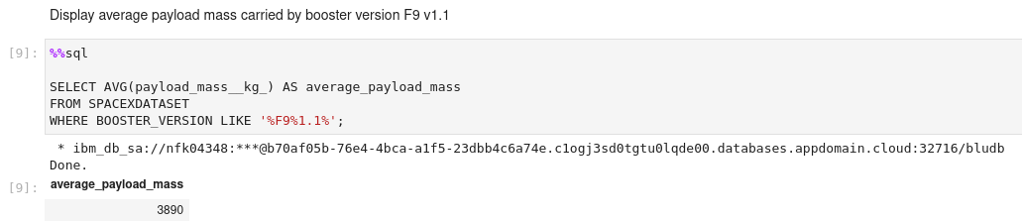
Average Payload Mass by F9 v1.1
Calculate the average payload mass carried by booster version F9 v1.1:
The average payload mass for the designated booster was 3890 Kg.

Slide 47
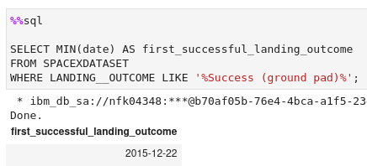
First Successful Ground Landing Date
Find the dates of the first successful landing outcome on ground pad:
The minimum (lowest number) date for a successful ground pad landing was 22 Dec 2015. We used the like command to with wild card characters to capture any strings that contained the key phrase.

Slide 48
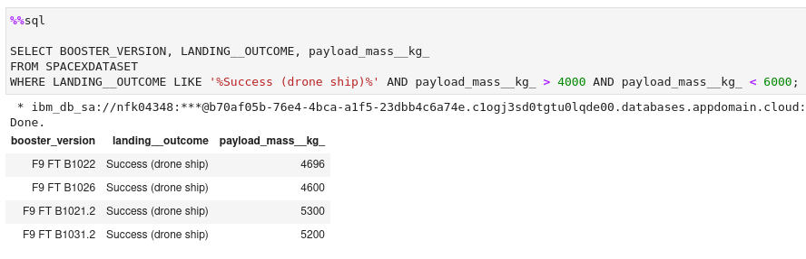
Successful Drone Ship Landing with Payload between 4000 and 6000
List the names of boosters which have successfully landed on drone ship and had payload mass greater than 4000 but less than 6000:
This query is similar to others before, we just this time use logical AND statements and < or > signs to limit the payload mass to specified range

Slide 49
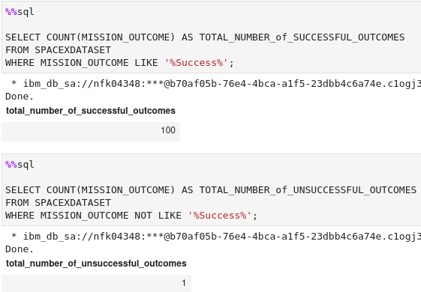
Total Number of Successful and Failure Mission Outcomes
Calculate the total number of successful and failure mission outcomes to the right:
Here we just count the number of times the mission outcome includes success to determine the #, which is 100 success. We then just negate this to obtain the 1 unsuccessful outcome (this criteria includes ANY and ALL forms that can be defined as success.

Slide 50
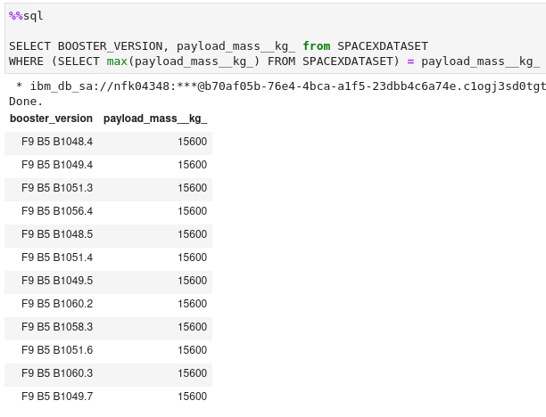
Boosters Carried Maximum Payload
List the names of the booster which have carried the maximum payload mass:
Here we determined the maximum payload that was carried, and then used this to limit and only match the attribute payload_mass_kg values that matched this. The results are shown to the right.

Slide 51
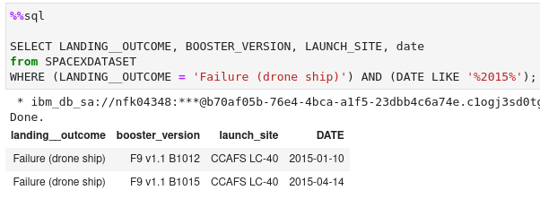
2015 Launch Records
List the failed landing_outcomes in drone ship, their booster versions, and launch site names for in year 2015
Here we do a basic query where we limit the returned values to landing outcome that meets the drone ship requirement, as well as in the year 2015

Slide 52
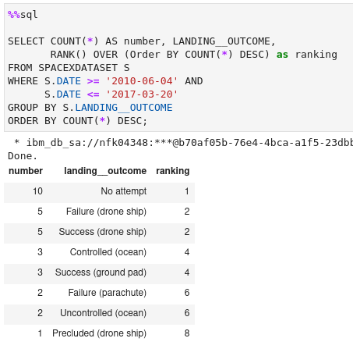
Rank Landing Outcomes Between 2010-06-04 and 2017-03-20
Rank the count of landing outcomes (such as Failure (drone ship) or Success (ground pad)) between the date 2010-06-04 and 2017-03-20, in descending order
Here we limit the date range and group data by the landing outcome, in descending order. I used the RANK() command over the Order by statement to get the cool ranking

Slide 53

Section 3

Slide 54
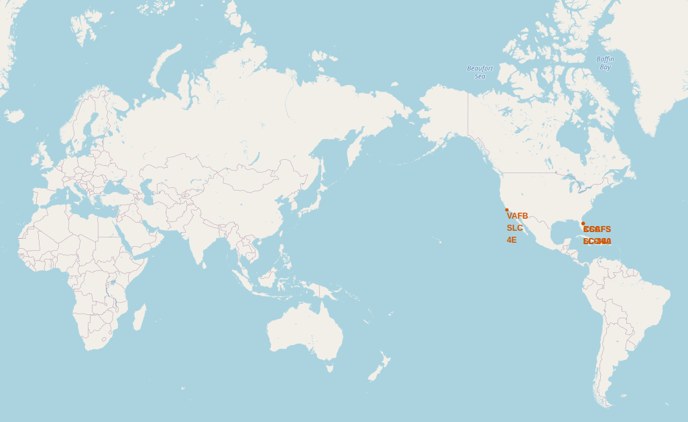
Folium Map Screenshot launch sites’ with all location markers on a global map
Folium map with all launch sites’ location markers on a global map (right):
Our map shows the four launch location, one in CA and three in Fl. Note that all launch sites are in the 28.5 deg to 34.7 deg lat range

Slide 55
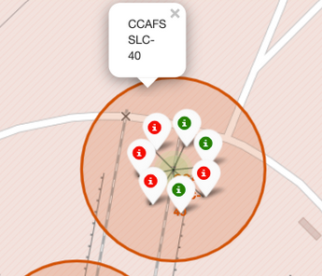
Folium Map with an example of the color-labeled launch outcomes
A folium map with an example of the color-labeled launch outcomes
This example uses markers to demonstrate red for failure, green for success for individual launches from the CCAFS SLC-40 launch site

Slide 56
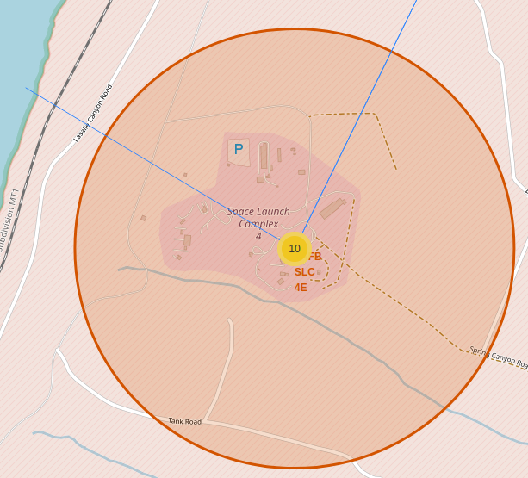
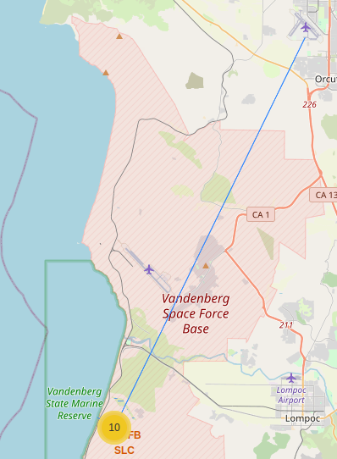
Folium map showing lines from Vandenburg launch to the coastline and to the US Forest Service Jet Center in Santa Maria, CA
Folium map showing lines from Vandenburg launch to the coastline and to the US Forest Service Jet Center in Santa Maria, CA
Distance from Vandenburg Launch to Land's End 1.427 km.
Distance from Vandenburg Launch to USFS Santa Maria Air Base 32.116 KM

Slide 57

Section 4

Slide 58
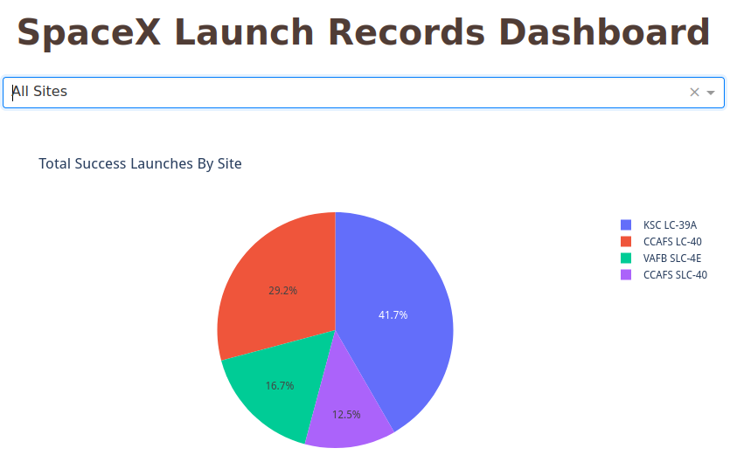
Pie chart showing Total Launch Success by launch site for all sites
Pie chart showing Total Success Launches by launch site for all sites
41.7% (the highest) were launched from KSC

Slide 59
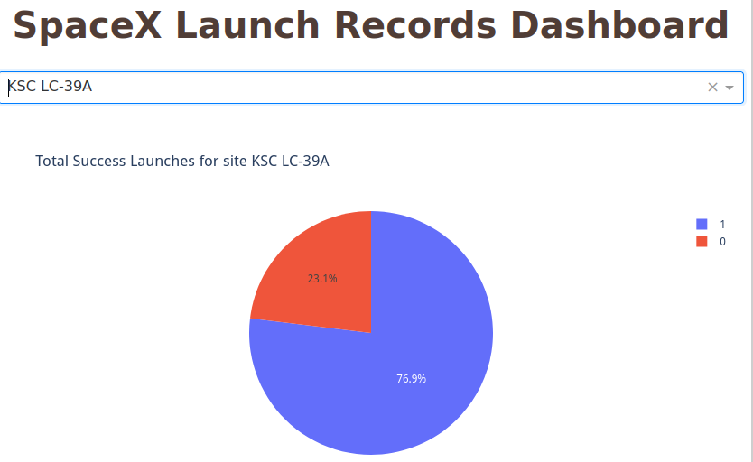
Pie chart for the launch site with highest launch success ratio
Pie chart for the launch site with highest launch success ratio is KSC
76.9% of all launches were successful!

Slide 60
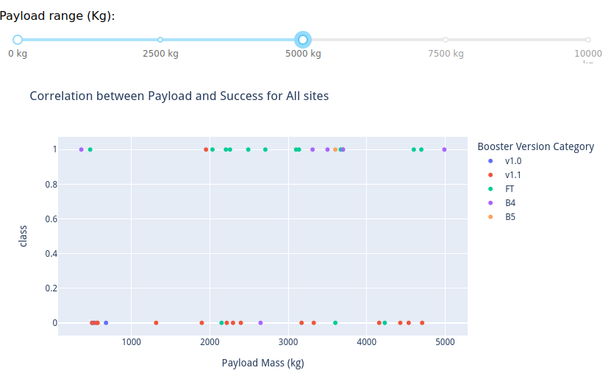
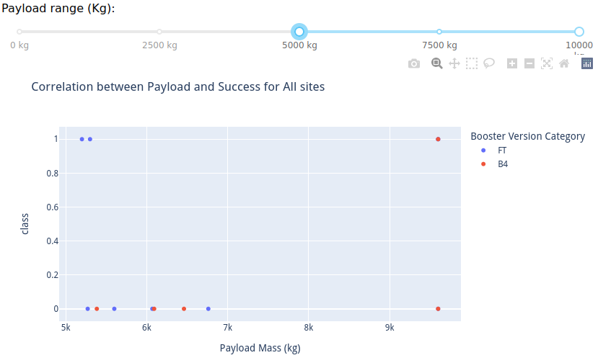
Payload vs. Launch Outcome scatter plot for all sites, with different payloads selected in the range slider
Payload vs. Launch Outcome scatter plot for all sites, with different payloads selected in two examples on the range slider
Analysis shows that the lower/mid range payloads had a higher success rate than the higher payload ranges, as shown at the right.
The FT booster looks good above 5000 kg, whereas the v 1.1 shows far more failures than successes at lower payloads.

Slide 61

Section 5

Slide 62
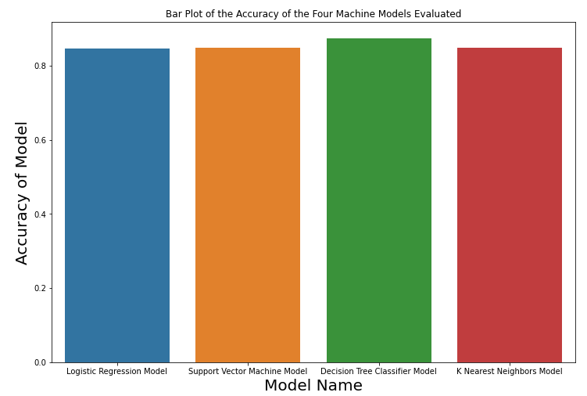
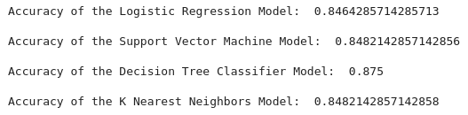
Classification Accuracy
A bar chart is shown to the right for the accuracy of the four machine models evaluated
In my analysis, the machine model that has the highest classification accuracy is the Decision Tree Classifier at 87.5 %

Slide 63
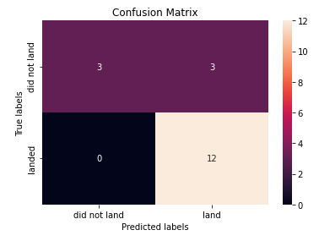
Confusion Matrix
The confusion matrix for the Decision Tree Classifier is shown to the right.
We see the same issues here as we did in all of the confusion matrix's evaluated – the models are very good at correctly predicting 'did land' or 'did not land'. The issue is relatively small percentage wise, but it is in false positives (3/18) = 16.7%

Slide 64
Conclusions
The best performing machine model in terms of accuracy is the Decision Tree Classifier at 87.5%
The success rate is generally increasing over time, a very good sign that the organization is successfully implementing redesigns and continuous improvement programs!
CCAFS LC-40, has a success rate of 60 %, while KSC LC-39A and VAFB SLC 4E have a success rate of 77%.
Unfortunately, the Project doesn't provide more information in terms of fix cost and variable that is involved in a launch. But with the above assumptions, we can still clearly conclude A CLEAR COST ADVANTAGE for SpaceX in a very costly business.
Cost Advantages -> Higher Margins, Pricing Power -> Industry Leadership -> Industry Domination

Slide 65

Acknowledgements
I would like to thank the Palo Alto City Library for featuring their Upskill 2022 program. Thanks to the California State Library's American Rescue Plan Act (ARPA) program, Palo Alto City Library patrons have access to Coursera memberships for free.
For more information, check out:
https://library.cityofpaloalto.org/upskill-2022/

Slide 66
Appendix
Python code and other materials are available at my GitHub repo:
https://github.com/EasyAs12345
Additional resources include:
https://plotlygraphs.medium.com/
https://dash.gallery/Portal/
https://dash.plotly.com/
https://dash.plotly.com/dash-core-components
And of course …
https://www.coursera.org/learn/applied-data-science-capstone/home/welcome

Slide 67


